Slide 1
Do now
Quizizz code:
While you wait:
1. Name the 6 participant rights (6 marks)
2. Outline 3 parenting styles (6 marks)
Reminders:
Phones away
Bags on floor
Books out
Pens out
Whiteboard

Slide 2
Answers
Define the terms qualitative and quantitative data
Reminders:
Phones away
Bags on floor
Books out
Pens out

Slide 3
Attachment Theory – Bowlby (Phases in the development of attachment)
Vocabulary
Internal working model:
The child’s attachment relationship with their primary caregiver leads to the development of an internal working model (Bowlby, 1969).
This internal working model is a cognitive framework comprising mental representations for understanding the world, self, and others. It is this mental representation that guides future social and emotional behaviours as the child’s internal working model guides their responsiveness and trust of others and self.
There are three main features of the internal working model:
1- a model of others as being trustworthy
2 - a model of the self as valuable
3- a model of the self as effective when interacting with others
Concept Development
Checking for Understanding
Did Bowlby engage in experimental or non-experimental research? Explain. Explain the behaviours Bowlby observed from which he concluded that children try to maintain proximity to their mothers.

Slide 4
TURN AND TALK
Define attachment (2 marks)
Outline attachment theory (4 marks)
Prior to Harlow – why did Scientists believe babies attached to their caregivers? (2 marks)
What did Bowlby add to the theory of attachment? (5 marks)
Check your understanding

Slide 5
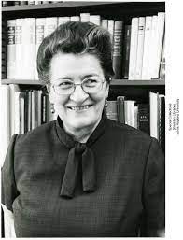
Ainsworth

Slide 6
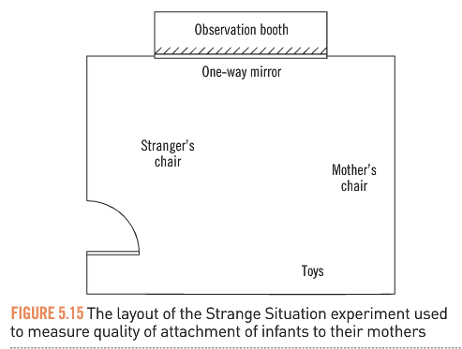
Attachment Theory – Ainsworth’ Strange Situation(1978)
Vocabulary
attachment: the close emotional bond or relationship between an infant and the primary caregiver (attachment theory aims to explain this relationship) infancy: roughly the first year of life surrogate: anyone/anything that ‘substitutes for’ or ‘plays the part of’ something else
Designed an experiment to researched the differences in the quality of attachment
Experiment took place in a room and then a fixed sequence of events was orchestrated:
The infant enters with the mother
The infant plays with mother present
A stranger enters
The mother leaves infant alone in room with the stranger (separation)
The mother returns (reunion)
The infant’s reactions were observed and recorded
Concept Development
Checking for Understanding
Describe Ainsworth’s research method.

Slide 7
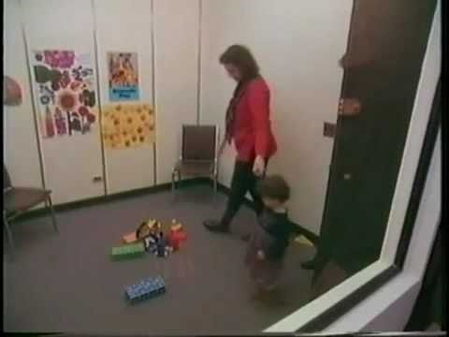
Attachment Theory – Ainsworth’ Strange Situation(1978)
Vocabulary
attachment: the close emotional bond or relationship between an infant and the primary caregiver (attachment theory aims to explain this relationship) infancy: roughly the first year of life surrogate: anyone/anything that ‘substitutes for’ or ‘plays the part of’ something else
Concept Development
Checking for Understanding
Record your own observations of the infants’ reactions.

Slide 8
Attachment Theory – Ainsworth’ Strange Situation(1978)
Vocabulary
attachment: the close emotional bond or relationship between an infant and the primary caregiver (attachment theory aims to explain this relationship) infancy: roughly the first year of life surrogate: anyone/anything that ‘substitutes for’ or ‘plays the part of’ something else
Through the observations Ainsworth catagorised 3 attachment types based on infant behaviour at 3 main stages of the observation:
Concept Development
 | Type A: Avoidant attached | Type B: Secure Attachment | Type C: Anxiously attached
Separation behaviour | Shows limited sign of distress when mother leaves | Distressed when mother leaves | Intense distress when mother leaves
Stranger Anxiety | Okay with stranger, plays normally when present | Avoidant of stranger when alone, friendly when mother is present | Fear of strangers and avoids
Reunion Behaviour | Little interest when mother returns | Positive and greets mother when she returns | Child is not easy to calm once mother has returned
Checking for Understanding
Distinguish Ainsworth’s categories of infant behaviour

Slide 9
Attachment Theory – Ainsworth’ Strange Situation (1978)
Vocabulary
attachment: the close emotional bond or relationship between an infant and the primary caregiver (attachment theory aims to explain this relationship) infancy: roughly the first year of life surrogate: anyone/anything that ‘substitutes for’ or ‘plays the part of’ something else
Ainsworth believes that attachment security depends on how sensitive and response a caregiver is to an infant’s signals:
Infants in Group B (securely attached) tend to have mothers who are more sensitive, accepting and expressive of affection towards them than the mothers of those who are insecurely attached.
Mothers of Group A types infants are insensitive to their signals, they do not often have close body contact with their infant, and instead of being affectionate, they are often irritable and behave in an angry manner.
The mother of Group C type infants are insensitive and awkward with their infants and are not affectionate, but not as rejecting as the Group A mothers
Concept Development
Checking for Understanding
Distinguish the behaviours of the mothers of each type of infant. How, according to Ainsworth, do different responses of mothers affected attachment?

Slide 10
Attachment Theory – Impact on later life
Vocabulary
attachment: the close emotional bond or relationship between an infant and the primary caregiver (attachment theory aims to explain this relationship) infancy: roughly the first year of life surrogate: anyone/anything that ‘substitutes for’ or ‘plays the part of’ something else
 | Type A: Avoidant attached | Type B: Secure Attachment | Type C: Anxiously attached
View of self | Extreme levels of self-reliance / values independence | appreciate your own self-worth | need to feel wanted and crave intimacy/ closeness
Long-term attachments | have a hard time with emotional intimacy and trusting people Escapist tendencies and attitudes | find satisfaction in being with others, openly seek support and comfort from your partner | Find it difficult to give partner space / observe their boundaries. Often anxious when apart
Concept Development
Checking for Understanding
Distinguish the behaviours of the mothers of each type of infant. How, according to Ainsworth, do different responses of mothers affected attachment?
Points to note:
Attachment types aren’t fixed, they can change
It is possible to change your attachment types and behaviours by unpacking childhood experience

Slide 11
WORK ON YOUR ASSESSSMENT.

